Slide 1


Slide 2
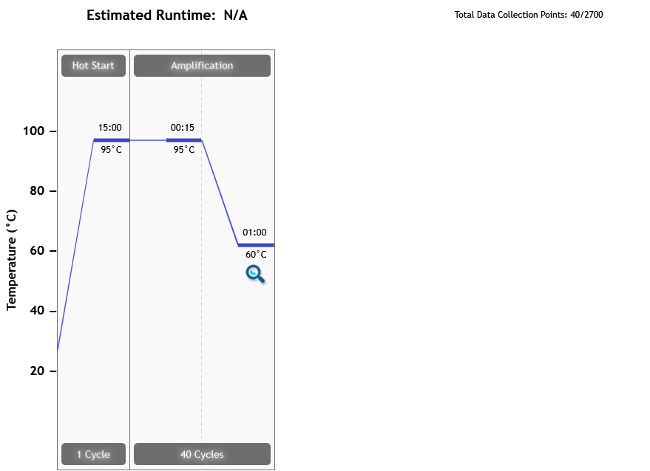
Thermal Profile
Page 2 of 8

Slide 3
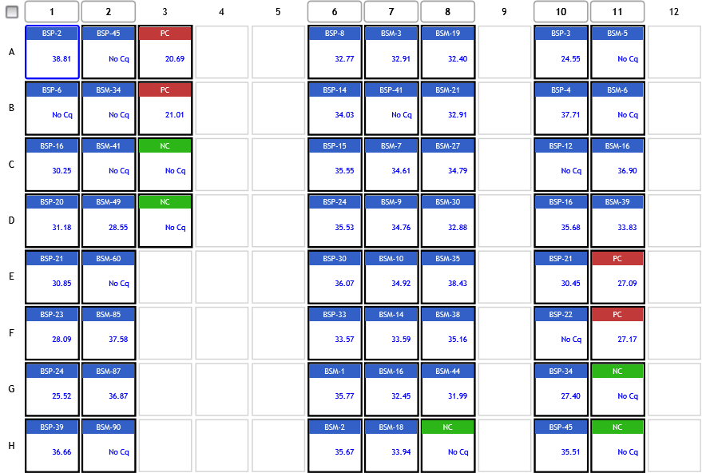
Analysis Criteria
Page 3 of 8

Slide 4
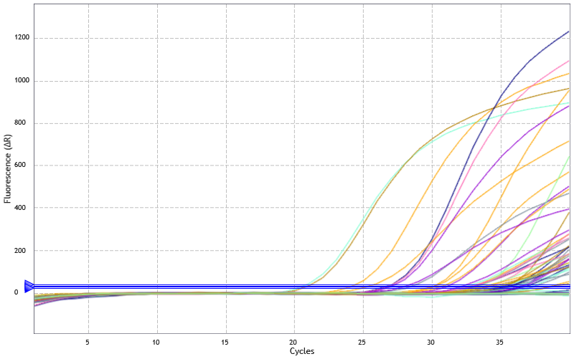
Amplification Plots
Threshold settings based on background: Start cycle = 5, End cycle = 9,
Sigma multiplier = 10, Baseline correction = Adaptive, Smoothing = On,
Crosstalk Correction: -
Page 4 of 8

Slide 5
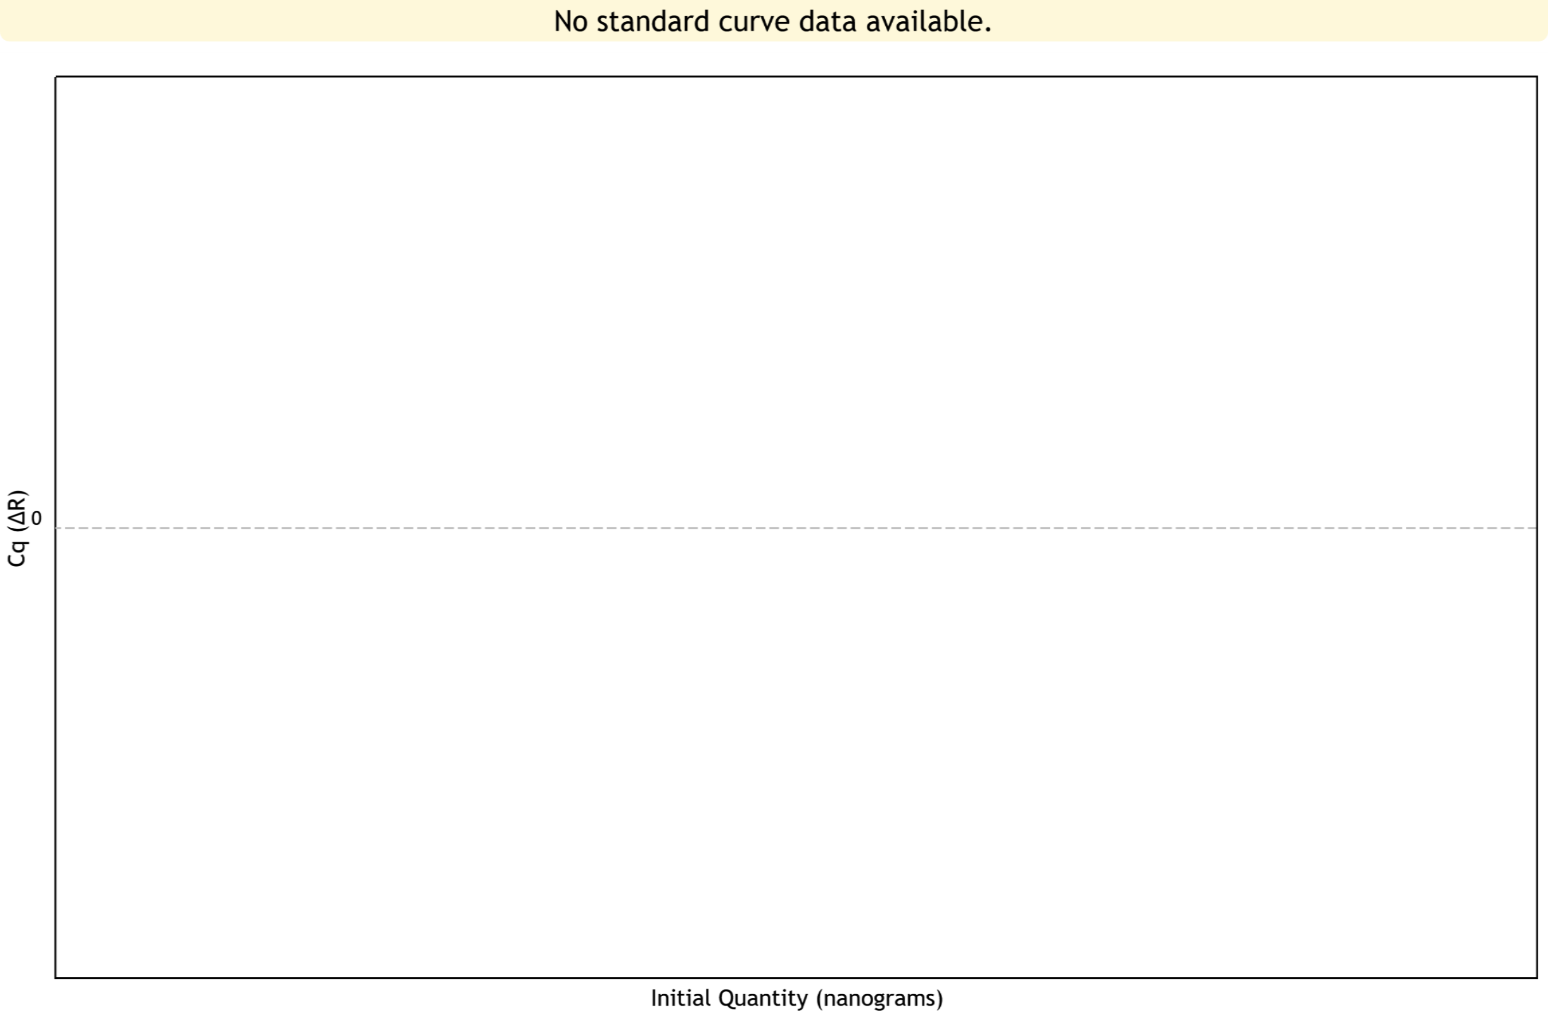
Standard Curve Plots
Confidence Level = Disabled
Page 5 of 8

Slide 6
Tabular Results (1 of 3)
Well | Well Name | Target | Cq (∆R) | Final Call (∆R)
A1 | BSP-2 | P.m | 38.81 | +
A2 | BSP-45 | P.m | No Cq | -
A3 | PC | P.m | 20.69 | +
A6 | BSP-8 | P.f | 32.77 | +
A7 | BSM-3 | P.f | 32.91 | +
A8 | BSM-19 | P.f | 32.40 | +
A10 | BSP-3 | P.o | 24.55 | +
A11 | BSM-5 | P.o | No Cq | -
B1 | BSP-6 | P.m | No Cq | -
B2 | BSM-34 | P.m | No Cq | -
B3 | PC | P.m | 21.01 | +
B6 | BSP-14 | P.f | 34.03 | +
B7 | BSP-41 | P.f | No Cq | -
B8 | BSM-21 | P.f | 32.91 | +
B10 | BSP-4 | P.o | 37.71 | +
B11 | BSM-6 | P.o | No Cq | -
C1 | BSP-16 | P.m | 30.25 | +
C2 | BSM-41 | P.m | No Cq | -
C3 | NC | P.m | No Cq | -
C6 | BSP-15 | P.f | 35.55 | +
C7 | BSM-7 | P.f | 34.61 | +
C8 | BSM-27 | P.f | 34.79 | +
C10 | BSP-12 | P.o | No Cq | -
C11 | BSM-16 | P.o | 36.90 | +
Page 6 of 8

Slide 7
Tabular Results (2 of 3)
Well | Well Name | Target | Cq (∆R) | Final Call (∆R)
D1 | BSP-20 | P.m | 31.18 | +
D2 | BSM-49 | P.m | 28.55 | +
D3 | NC | P.m | No Cq | -
D6 | BSP-24 | P.f | 35.53 | +
D7 | BSM-9 | P.f | 34.76 | +
D8 | BSM-30 | P.f | 32.88 | +
D10 | BSP-16 | P.o | 35.68 | +
D11 | BSM-39 | P.o | 33.83 | +
E1 | BSP-21 | P.m | 30.85 | +
E2 | BSM-60 | P.m | No Cq | -
E6 | BSP-30 | P.f | 36.07 | +
E7 | BSM-10 | P.f | 34.92 | +
E8 | BSM-35 | P.f | 38.43 | +
E10 | BSP-21 | P.o | 30.45 | +
E11 | PC | P.o | 27.09 | +
F1 | BSP-23 | P.m | 28.09 | +
F2 | BSM-85 | P.m | 37.58 | +
F6 | BSP-33 | P.f | 33.57 | +
F7 | BSM-14 | P.f | 33.59 | +
F8 | BSM-38 | P.f | 35.16 | +
F10 | BSP-22 | P.o | No Cq | -
F11 | PC | P.o | 27.17 | +
G1 | BSP-24 | P.m | 25.52 | +
G2 | BSM-87 | P.m | 36.87 | +
Page 7 of 8

Slide 8
Tabular Results (3 of 3)
Well | Well Name | Target | Cq (∆R) | Final Call (∆R)
G6 | BSM-1 | P.f | 35.77 | +
G7 | BSM-16 | P.f | 32.45 | +
G8 | BSM-44 | P.f | 31.99 | +
G10 | BSP-34 | P.o | 27.40 | +
G11 | NC | P.o | No Cq | -
H1 | BSP-39 | P.m | 36.66 | +
H2 | BSM-90 | P.m | No Cq | -
H6 | BSM-2 | P.f | 35.67 | +
H7 | BSM-18 | P.f | 33.94 | +
H8 | NC | P.f | No Cq | -
H10 | BSP-45 | P.o | 35.51 | +
H11 | NC | P.o | No Cq | -
Page 8 of 8

